Slide 1





Presentation on
Open ai Powered dEsktop assistant
By:
1.Nikita Khetmalis –B68 2. Vrushali pimpale-B67
Under The Guidance of
Prof:Yogesh Mali Sir

Slide 2
Contents
Introduction
Justifications for Selecting the Title
Problem Statement
Hardware Requirement
Software Requirement
Module Used
Literature Survey
Block Diagram
Expected Result
Work plan
References

Slide 3
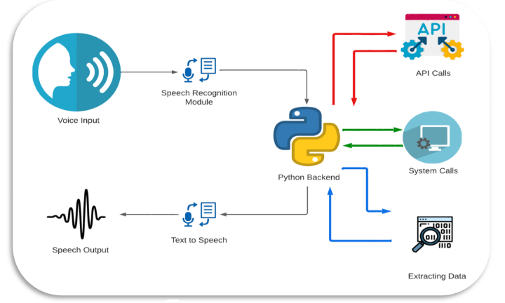
Introduction
An OpenAI-powered desktop assistant designed to enhance automate tasks, and provide intelligent, context-aware support directly on a user's desktop environment.
This innovative software leverages OpenAI's advanced natural language understanding and generation technologies to create a dynamic and interactive assistant that can comprehend and respond to user queries and commands in a human-like manner..

Slide 4
Justification For Selecting The Title
Pronunciation and Familiarity
Human-Like Persona
Professional and Friendly
Memorability
Modern Appeal
Natural Language Processing

Slide 5

Problem Statement
In today's fast-paced digital environment, individuals and organizations encounter various challenges related to information management, and task automation. These challenges often lead to inefficiencies, time wastage, and an overwhelming amount of data to process. To address these issues, there is a need for an intelligent and user-friendly desktop assistant powered by OpenAI's advanced natural language processing capabilities

Slide 6
Module Used
Speech Recognition:- Since we’re building an Application of voice assistant, one of the most important things in this is that your assistant recognizes your voice
Pyttsx3: This module is used for the conversion of text to speech in a program it works offline.
Datetime: Date and Time are used to showing Date and Time
Subprocess: This allows us to modify and operate on the files in the device.
Wikipedia: This module helps in opening wikipedia and searching for what the user asks.
Winshell and Os: This module helps in accessing the files and folders in the device
Web browser:- To perform Web Search

Slide 7
Literature Survey
Sr. No. | Paper Title and its Author | Details of Publication | Findings
1 | 2023 5th Biennial International Conference on Nascent Technologies in Engineering (ICNTE) Author- Pankaj Kuneka, Ajinkya Deshmukh, Sachin Gajalwad and many more. | Date of Conference: 20-21 January 2023 Date Added to IEEE Xplore: 12 June 2023 | https://ieeexplore.ieee.org/document/10146699
2 | International Conference on Trends in Electronics and Informatics (ICEI) Author: Tata Jagannadha Swamy, M. Nandini V. Laxmi Anvitha and many more. | Date of Conference: 28-30 April 2022 Date Added to IEEE Xplore: 24 May 2022 | https://ieeexplore.ieee.org/document/9776746
3 | International Conference on Communication and Electronics Systems (ICCES) Author: Padmavati Sarode, Jaydeep Ghosh, Hardik Muley and many more. | Date of Conference: 01-03 June 2023 Date Added to IEEE Xplore: 01 August 2023 | https://ieeexplore.ieee.org/document/10192894

Slide 8
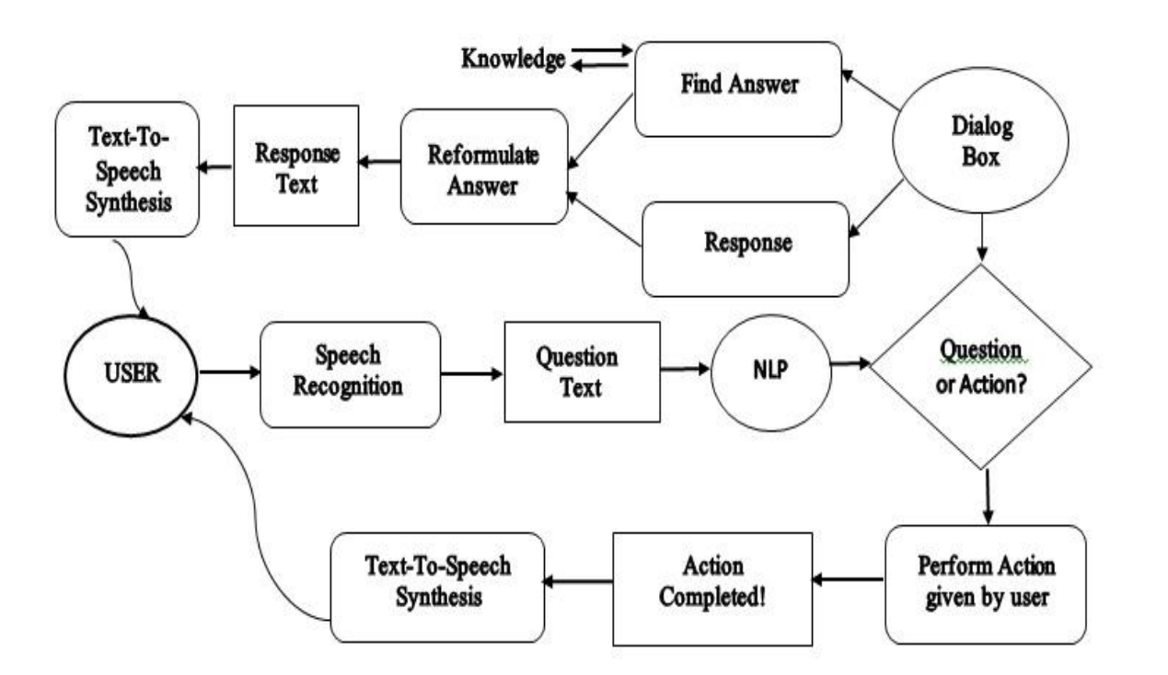
Block Diagram

Slide 9
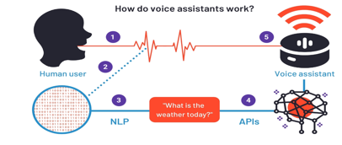
Expected Result
Provide Valuable Information
Natural Language Understanding
Voice and Text Interaction
It Can Play Music from Computer or from Youtube.
It can do Searches from Google for you
It is Capable of opening websites like Google , Youtube etc
It is capable of opening apps like code editor , command prompt, notepad, chrome
It is capable for Checking the Weather updates
It is capable for Giving The Answers Like Chatgpt
User can send WhatsApp Message using voice command
Our program can play music available on device
Conducting an online search
Reading Wikipedia
Applications that are open
Play music from a folder on your computer's desktop
Listen to music via YouTube
Obtain the current date and time

Slide 10
Work – Plan
Months Activities | July’23 | August’23 | Sep’23 | Oct’23
Literature Reviews | √
Requirement Analysis | √
Designing | √ | √
Experimental Analysis | √ |  | √
Module wise Implementation |  | √ |  | √
Testing and Debugging |  |  | √ | √
Preparation of Project Report |  |  |  | √

Slide 11
Software And Hardware Required
Hardware Requirements
Microphone and Speaker
Ram = 8GB
Operating System
Memory(RAM)
Processor
Software requirements
Python(any version)
Visual Studio Code, Anaconda
speech recognition libraries
Python Modules
Pycharm

Slide 12
References
[1] Dr. Kshama, V. Kulhalli, Dr. Kotrappa Sirbi, Mr.Abhijit J. Patankar, “Personal Assistant with Voice Recognition Intelligence,” International Journal of Engineering Research and Technology. vol 10, no.1, pp. 416-418, (2017).
[2] Kukade, Ruchita G. Fengse, Kiran D. Rodge, Siddhi P. Ransing, Vina M. Lomte"Virtual Personal Assistant for the Blind,” International Journal of Computer Science and Technology (JCST), vol 9, Issue 4, PP.2251-2253,October - December 2018.
[3] TusharGharge, ChintanChitroda, NishitBhagat, KathapriyaGiri, “AISmart Assistant,” International Research Journal of Engineering andTechnology (IRJET), vol: 06 Issue: 01,PP-3862-3863,January 2019
[4] M. A. Jawale, A. B. Pawar, D. N. Kyatanavar, “Smart Python Coding through Voice Recognition,” International Journal of Innovative Technology and Exploring Engineering (IJITEE), vol: 8 Issue-10, PP-3283-3284, August 2019.
[5] Isha S. Dubey, Jyotsna S. Verma, Ms.ArundhatiMehendale, "An Assistive System for Visually Impaired using Raspberry Pi," International Journal of Engineering Research & Technology (IJERT), vol 8 Issue 05, PP-608-609, May 2019.
[6] VetonKëpuska, "Next-Generation of Virtual Personal Assistants (Microsoft Cortana, Apple Siri, Amazon Alexa, and Google Home)," International Journal for Research in Applied Science & Engineering Technology (IJRASET), vol 10 Issue 04, PP-2251-2253 Apr 2022.

Slide 13
Thank you !

